Slide 1
SANTA CLARA

Slide 2
Introducing AWS App Mesh
MAD303
Nick Coult
Principal product manager
AWS

Slide 3
Agenda
Some whys …
Why a service mesh?
Why App Mesh?
And some hows …
App Mesh constructs
Integrating App Mesh with services
Demo
Roadmap
Partners

Slide 4
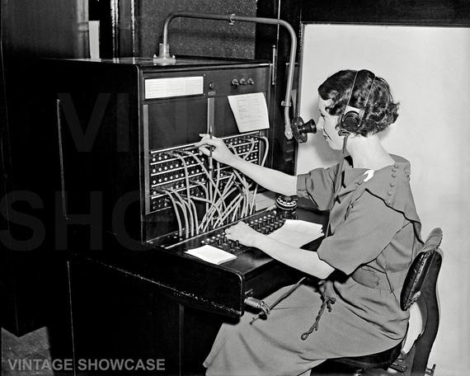

App Mesh: Application-level communication across AWS
Communicating between instances
Fixed endpoints at specific addresses
Firewall to allow or block connection attempts
Service discovery
Real-time map of service availability
Applications accept or reject calls
Notes:
A lot of our investment last year and going forward is going to be in this concept of what we call application level networking, application level communications across AWS. Historically when you have run anything to do with containers one of the first things you have to do is set up your network – that’s your virtual private cloud or VPC in AWS parlance. And everything happens in the context of the VPC. In Fargate for example, we have this notion of a cluster. That’s not a cluster of physical machines. We call it that to be API compatible with ECS. Really, it’s just a subnet in a virtual private cloud – it’s an isolated network. But that is the first thing you have to set up.
If you are running microservices, what you really, really care about is: What is my application allowed to talk to? Which AWS resources can I access? What are my policies? How do I set up my network policies? And that is what App Mesh tries to do. We think of it as an AWS-level service mesh that relies on things like Cloud Map to get a map to every other AWS resource. And you deploy your services to that. Whether they are running on ECS, Fargate, EKS, EC2, or even Lamdba or API Gateway, it doesn’t matter, you are running services on AWS. You need an application level network to layer that into. And App Mesh is step one in what we want to do here.

Slide 5
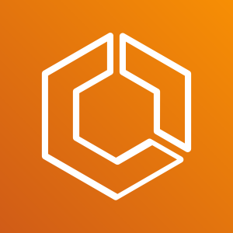
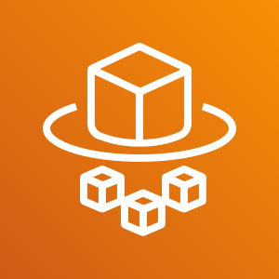
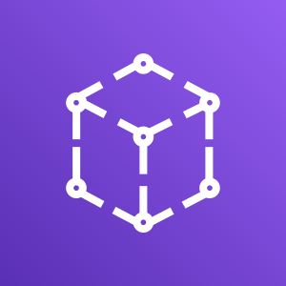
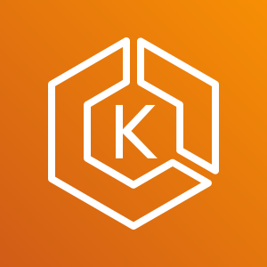

App Mesh works across compute services
Amazon ECS
AWS Fargate
Amazon EKS
AWS App Mesh
Amazon EC2
Notes:
App mesh works with all of these. You can also run a single mesh across all of them!

Slide 6
Why a service mesh?
Nitin Mahajan
Executive Director, Service Engineering
Edmunds.com

Slide 7

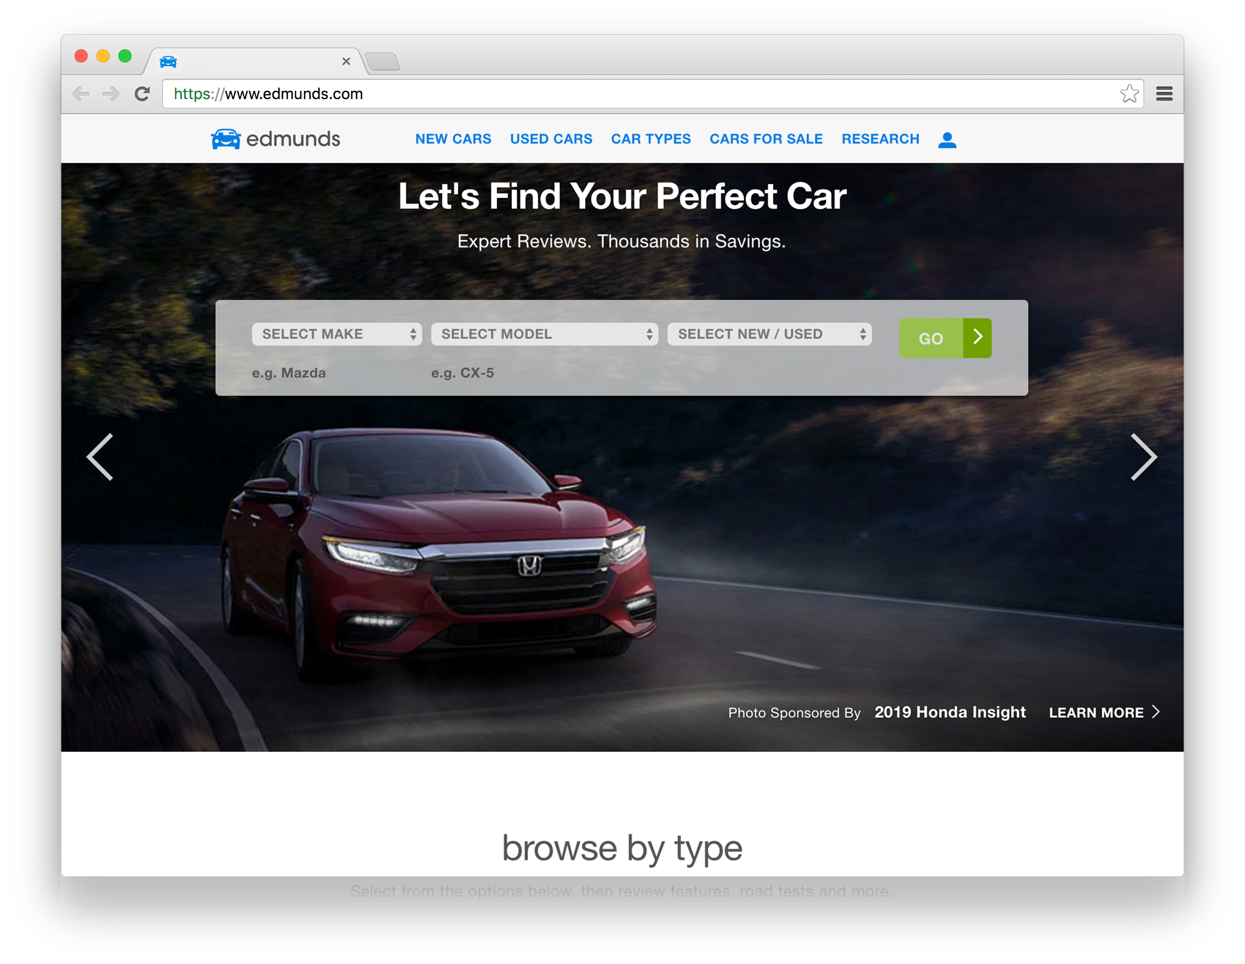



Our Platform
10K Dealer
Partners
20 MILLION
Monthly Car Shoppers
Major Car Manufacturers
Notes:
On the business side
We help car manufacturers market their current new car models;
And help over 20M car shoppers who visit our website each month connect with the over 10k dealerships
…… And one thing you should know is that we at Edmunds loves cars
So much so that…

Slide 8

Notes:
… to celebrate our 50th Anniversary, we placed a 1966 corvette stingray on a rotating turntable in our atrium,
It was state of the art for its time: it was fast, nimble and really fun to drive.
But we also wanted it to represent our Company’s continuous reinvention

Slide 9
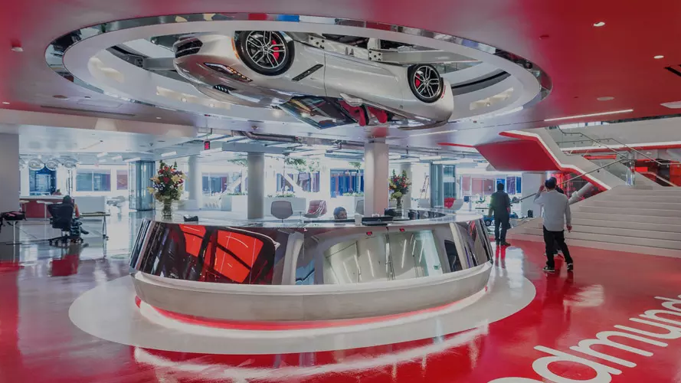
Notes:
on the flip side we mounted upside down the MODERN version of the Corvette,
rotating on the ceiling above the reception desk
The evolution from one model to the other took 50 YEARS.
Today I want to share with you a similar transformation from Monolith to Microservices Architecture to meet the MODERN demands of the digital age.
What are Microservices and Why you need them.
Few guidelines on transitioning from Monolith to Microservices.
The missing Piece

Slide 10
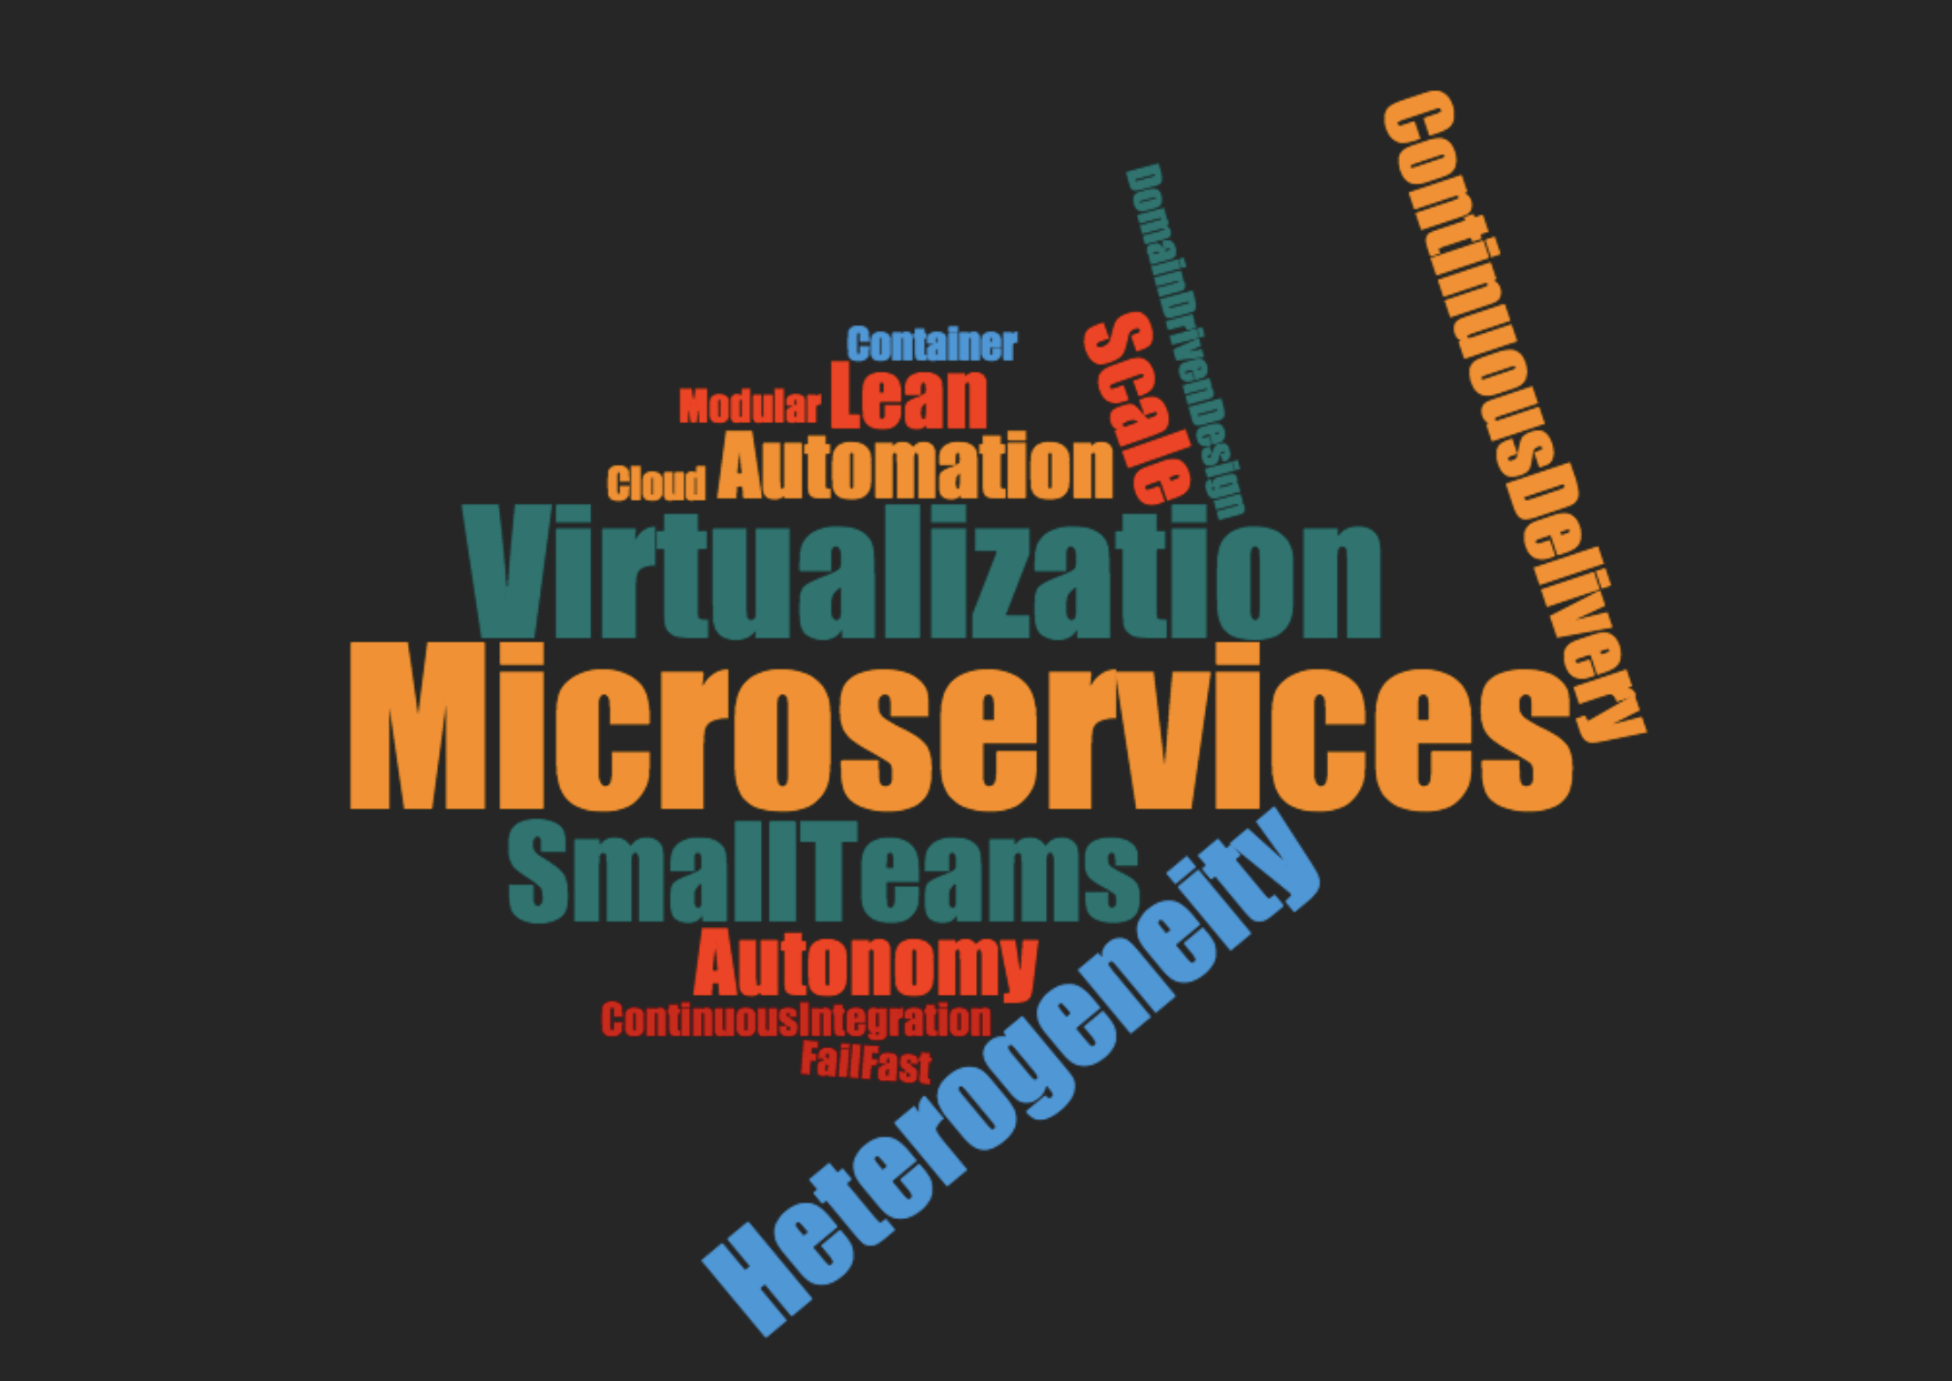
Notes:
What Are Microservices
Small, and Focused on Doing One Thing Well
something that could be rewritten in two weeks.
Single Responsibility Principle.
Microservices has emerged from this world of DDD, ____.
When Do I build Microservice
When Complexity & Team Sizes Grows.

Slide 11

“Being challenged in life is inevitable, being defeated is optional.”
Roger Crawford
Notes:
… we at Edmunds have achieved major milestones in this Microservices Journey. Every Journey comes with its challenges.
we face challenges due to the lack systems to provide visibility and enforce Microservice Principles..
Decision, Current State & Impact. Reason for Current State

Slide 13
ARCHITECTURE : MICROSERVICES
MODERN SOFTWARE DEVELOPMENT
SMALL CROSS FUNCTIONAL TEAMS
CONTINUOUS DEPLOYMENT

Slide 14

Business Capability
Subdomain
Notes:
Sub-domain refers to the problem space whereas bounded context refers to the solution space

Slide 15
Service Teams
Product
teams
Database
Java
Node.js
Product
teams
Platform
teams
Java
Database
Node.is
Java
Java
Database
Java
Java
Database
Infrastructure team
Notes:
Speaker notes:
Microservice Simplified View

Slide 16
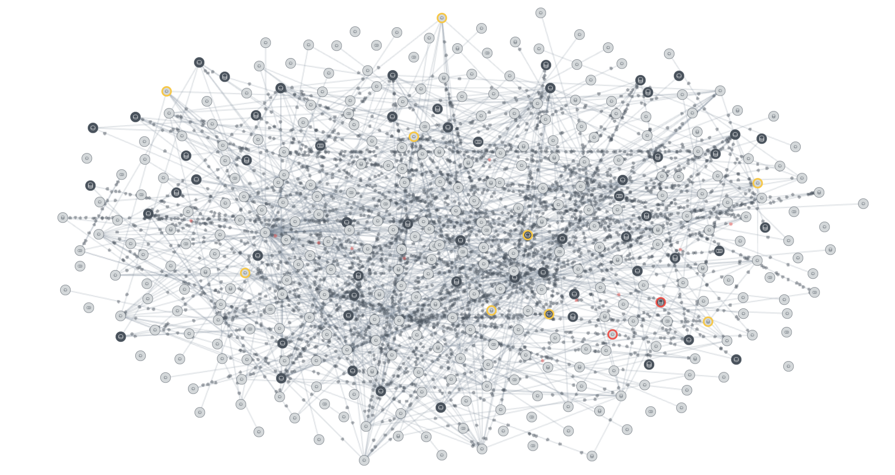
Notes:
Speaker notes
220 Containers, 700+ EC2 Instances
Stats on Containers, Applications Databases, Servlerless
Teams
DevOwnOps – Different Service Accounts for Teams for full Autonomy

Slide 17
Challenges with Microservices
Control Over Service to Service Communication
Visibility into Service to Service Communication i.e Observability
Create a culture of innovation by organizing into small DevOps teams
Ensure trust by automating security and compliance

Slide 18
What is needed
Consistent communications
management
Complete visibility
Failure isolation and protection
Fine-grained deployment controls
Notes:
Communication – people and systems
Observe
Orient
Decide
Act

Slide 19
Why App Mesh?

Slide 20
Instance to instance, inter-service traffic management and monitoring
A
http/tcp
B
uniform logs, metrics and traces
load balancing traffic
shift traffic between deployments
minimimal impact to application code
Service A
Service B
Notes:
Service A uses Service B. The two services are managed by different service teams. Both are deployed on AWS.
A is a Java application on EC2.
B is a containerized Go app running on Fargate.
Want both A and B to use the same logging format and send logs to CloudWatch.
Want both to use same tracing system.
Want B to be able to deploy a new version in a canary deployment and not have A have to know that’s happening or make any changes to A.

Slide 21
metal-v1
dj
jazz-v1
Notes:
Service A uses Service B. The two services are managed by different service teams. Both are deployed on AWS.
A is a Java application on EC2.
B is a containerized Go app running on Fargate.
Want both A and B to use the same logging format and send logs to CloudWatch.
Want both to use same tracing system.
Want B to be able to deploy a new version in a canary deployment and not have A have to know that’s happening or make any changes to A.

Slide 22
Why App Mesh?
Proxy
Sits between all services
Manages and observes traffic
Control plane
Translates intent to proxy config
Distributes proxy config
A
http/tcp
B
Notes:
In App Mesh we use a proxy with a managed control plane.
The proxy manages the traffic between services and can observe that traffic.
You express your intent through App Mesh API and constructs. The control plane translates that intent into proxy config and distributes it to the proxies.

Slide 23
pod
Proxied traffic is
observable and shapeable.
your app container
External traffic
App Mesh, Envoy-based sidecar container
A
http/tcp
B
Notes:
In App Mesh we use a proxy with a managed control plane.
The proxy manages the traffic between services and can observe that traffic.
You express your intent through App Mesh API and constructs. The control plane translates that intent into proxy config and distributes it to the proxies.

Slide 24
A
http/tcp
B
Notes:
In App Mesh we use a proxy with a managed control plane.
The proxy manages the traffic between services and can observe that traffic.
You express your intent through App Mesh API and constructs. The control plane translates that intent into proxy config and distributes it to the proxies.

Slide 25
metal-v2
metal
metal-v1
dj
jazz-v2
jazz
jazz-v1
Notes:
In App Mesh we use a proxy with a managed control plane.
The proxy manages the traffic between services and can observe that traffic.
You express your intent through App Mesh API and constructs. The control plane translates that intent into proxy config and distributes it to the proxies.

Slide 26

metal-v2
metal
metal-v1
dj
jazz-v2
jazz
Control Plane
jazz-v1
Notes:
In App Mesh we use a proxy with a managed control plane.
The proxy manages the traffic between services and can observe that traffic.
You express your intent through App Mesh API and constructs. The control plane translates that intent into proxy config and distributes it to the proxies.

Slide 27
metal-v2
metal
metal-v1
dj
jazz-v2
jazz
jazz-v1
Notes:
In App Mesh we use a proxy with a managed control plane.
The proxy manages the traffic between services and can observe that traffic.
You express your intent through App Mesh API and constructs. The control plane translates that intent into proxy config and distributes it to the proxies.

Slide 28
metal
metal-v1
dj
jazz
jazz-v1
Notes:
In App Mesh we use a proxy with a managed control plane.
The proxy manages the traffic between services and can observe that traffic.
You express your intent through App Mesh API and constructs. The control plane translates that intent into proxy config and distributes it to the proxies.

Slide 29
metal
dj
jazz
Notes:
In App Mesh we use a proxy with a managed control plane.
The proxy manages the traffic between services and can observe that traffic.
You express your intent through App Mesh API and constructs. The control plane translates that intent into proxy config and distributes it to the proxies.

Slide 30
Control plane
Proxy
Sits between all services
Manages and observes traffic
Control plane
Translates intent to proxy config
Distributes proxy config
A
http/tcp
B
Service
team A
Service
team B
Notes:
In App Mesh we use a proxy with a managed control plane.
The proxy manages the traffic between services and can observe that traffic.
You express your intent through App Mesh API and constructs. The control plane translates that intent into proxy config and distributes it to the proxies.

Slide 31
Why a side-car proxy?
Decouples install/upgrade
Configurable: Separates business logic from operations
Proxy
Minimizes inconsistencies

Slide 32
Task or pod
Application code
External traffic
Proxy runs as a container

Slide 33
pod
your app container
External traffic
App Mesh, Envoy-based sidecar container

Slide 34
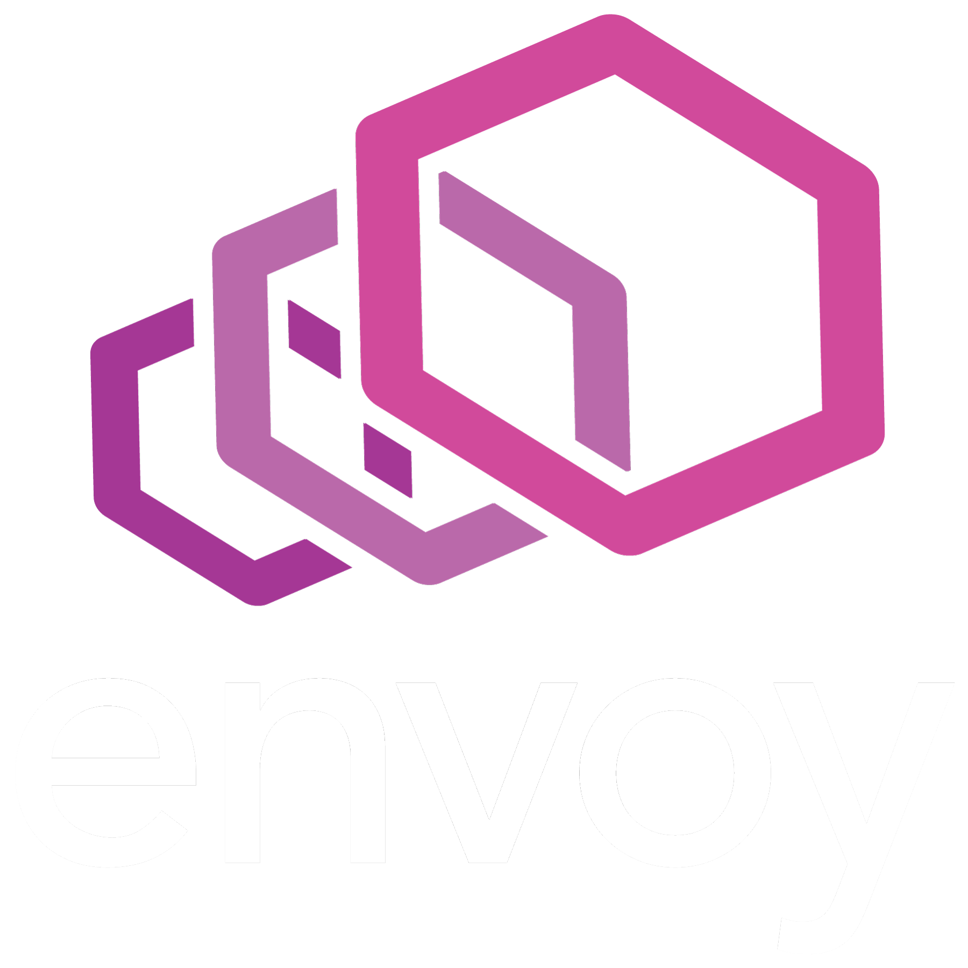
App Mesh uses Envoy Proxy
OSS project
Wide community support, numerous integrations
Stable and production-proven
Graduated Project in Cloud Native Computing Foundation
Started at Lyft in 2016

Slide 35
Notes:
When a service starts, the envoy proxy running alongside checks in with App Mesh and receives configuration information. This includes how to connect to monitoring services, routing logic, and deployment logic.

Slide 36
App Mesh control plane configures every proxy
Notes:
When a service starts, the envoy proxy running alongside checks in with Lattice and receives configuration information. This includes how to connect to monitoring services, routing logic, and deployment logic.

Slide 37
Application observability
Logging
HTTP access logging
Amazon CloudWatch Logs
Available as container logs on Amazon ECS, Amazon EKS, AWS Fargate
Metrics
CloudWatch metrics
StatsD (with tags)
Prometheus
Tracing
AWS X-Ray
Other Envoy tracing drivers

Slide 38
Client-side traffic management
Traffic shaping
Load balancing
Weight targets
Service discovery (DNS + AWS Cloud Map)
Health checks
Retries*
Timeouts*
Circuit breakers*
Routing controls
Protocols support (HTTP, TCP, gRPC*)
Path-based
Header-based*
Cookie-based*
Host-based*
*Coming soon
Notes:
App Mesh configures each microservice’s proxy to use desired retries, timeouts, and error-codes. App Mesh can enforce access controls, quotas, and limits for communications between microservices. These capabilities make it easier to deploy new versions of your microservices and help tune applications to be resilient to failures. *items are coming soon.

Slide 39

Today, App Mesh is generally available worldwide
Observability and traffic control
Easily export logs, metrics, and traces
Client-side load balancing, routing
AWS container services compatibility Amazon Elastic Container Service (Amazon ECS)
Amazon Elastic Container Service for Kubernetes (Amazon EKS)
AWS Fargate
EC2 compatibility
Integrate with services running directly on EC2 instances

Slide 40
How it works

Slide 41
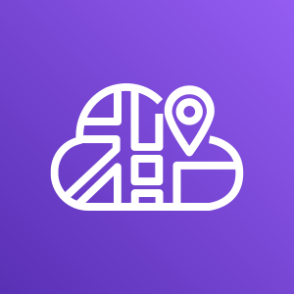
App Mesh constructs
Mesh
Virtual node
Virtual router and routes
Virtual service
Create and manage these in App Mesh API, CLI, SDK, or AWS Management Console
Proxies
Services
Service discovery
Configure and run proxies and services on Amazon ECS, Fargate, Amazon EKS, Amazon EC2
Service discovery with
AWS Cloud Map
Notes:
Source virtual-node: A virtual-node that specifies a set of backends that it connects to (virtually)
Destination virtual-node: A virtual-node that specifies a listener and service-discovery. Only destination virtual-nodes can participate in routes.

Slide 42
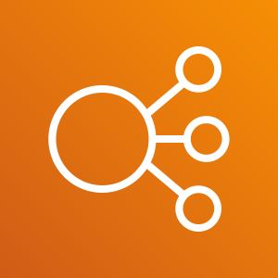
Colorteller: app.colortellerdemo.com
Gateway task
Colorteller task
Gateway container
Colorteller container
http
http
ALB
Gateway
GET /color returns a color
Uses Colorteller to retrieve the color
Colorteller
Returns a pre-set color (yellow)
Configured in service discovery as colorteller.local
Notes:
Envoy A knows what to do with the request because the control plane has translated the Virtual Service, Virtual Router, Route, and Virtual Nodes into an Envoy configuration.
Envoy A knows where to find Task B because of service discovery (done by the control plane). There can be many copies of Task B! Load balancing happens on the client side.

Slide 43

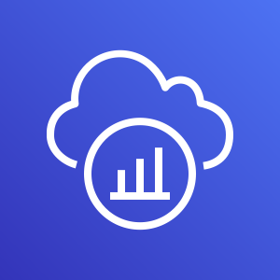
Colorteller app “meshified”: app.colortellerdemo.com
AWS X-Ray
Amazon Cloud Watch
Control plane
Gateway
Colorteller
Gateway container
Colorteller container
http
http
http
http
Gateway
Proxy applies routing rules (e.g., path matching)
Proxy does the load balancing if there is more than one Colorteller task running
Proxy does metrics, logging, and tracing
Colorteller
Proxy also does metrics, logging, and tracing
Notes:
Envoy A knows what to do with the request because the control plane has translated the Virtual Service, Virtual Router, Route, and Virtual Nodes into an Envoy configuration.
Envoy A knows where to find Task B because of service discovery (done by the control plane). There can be many copies of Task B! Load balancing happens on the client side.

Slide 44
Partners

Slide 45
Partners

Slide 46
Roadmap

Slide 47
Roadmap
Today
Client-side load balancing
Path-based routing
Egress traffic
AWS Cloud Map service discovery
App Mesh console
AWS X-Ray tracing
Envoy supported tracing
CloudWatch Logs, metrics
StatsD, Prometheus metrics
Amazon ECS, Fargate integration
Amazon EKS integration Amazon EC2 integration
Near term
AWS PrivateLink
Cloud Map selectors
gRPC routing
Header-based routing
Cookie-based routing
Host-based routing
Timeout policy
Retry policy
Circuit breaker policy
End-to-end encryption
Longer term
mTLS
Mesh peering
Global rate limiting
Managed ingress
Other protocols
Notes:
Preview channel on github coming soon.

Slide 48
Getting started
Product overview https://aws.amazon.com/app-mesh
Documentation https://docs.aws.amazon.com/app-mesh/index.html
Examples https://github.com/awslabs/aws-app-mesh-examples
Issues, roadmap, beta channel https://github.com/aws/appmesh-roadmap

Slide 49
Nick Coult
Principal product manager
AWS

